Slide 1
INTRODUCTION
INTRO TO ANDROID DEVELOPMENT

Slide 2
FIRSTLY, WE NEED TO UNDERSTAND WHAT ANDROID MEANS?
Android operating system (OS)

Slide 3

So from the basic knowledge we got from what android means, let’s apply that…
Android development

Slide 4
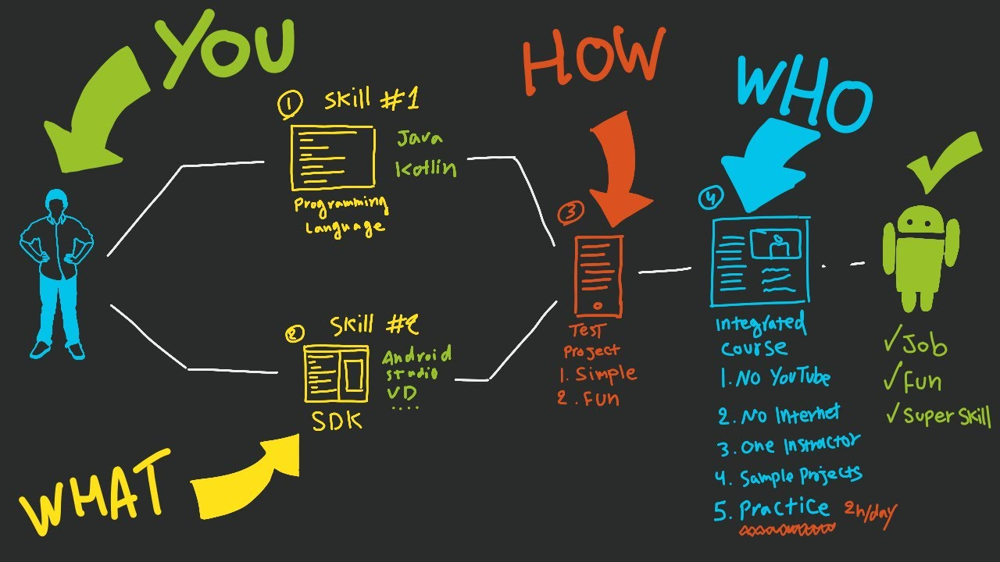
And we achieve that using the following tools…

Slide 5
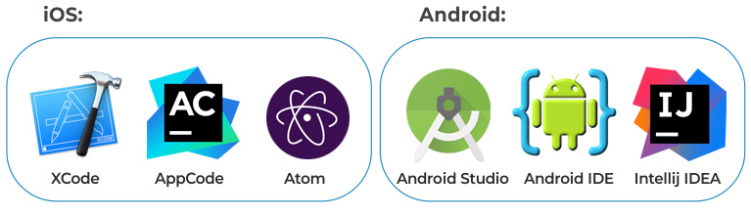

Slide 6
SO LET’S HEAD TO ANDROID STUDIO.

Slide 7
CONCLUSION

